Slide 1
Digital Earth GEOG-104
Yi Qiang
8/22/2017

Slide 2
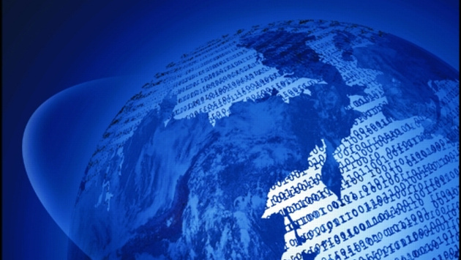
Digital Earth
What is Digital Earth?
Why we need Digital Earth?

Slide 3
The information explosion (the Big Data Era)
As of January 1, 2015, the Landsat satellites have archived 5.5 million images (~4134TB).
USGS Landsat archive holdings as of January 1, 2015

Slide 4
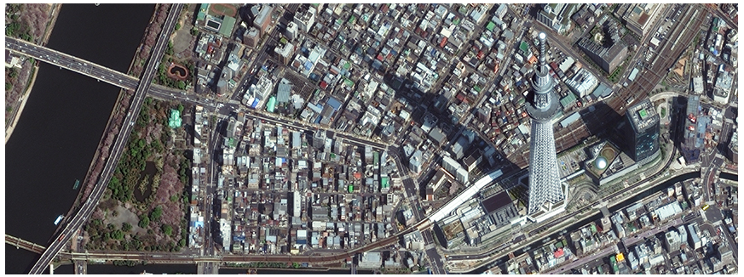
The information explosion (Big Data Era)
DigitalGlobe has archived 100-petabyte high-resolution satellite imagery since 2017.
Worldview images acquired by DigitalGlobe

Slide 5
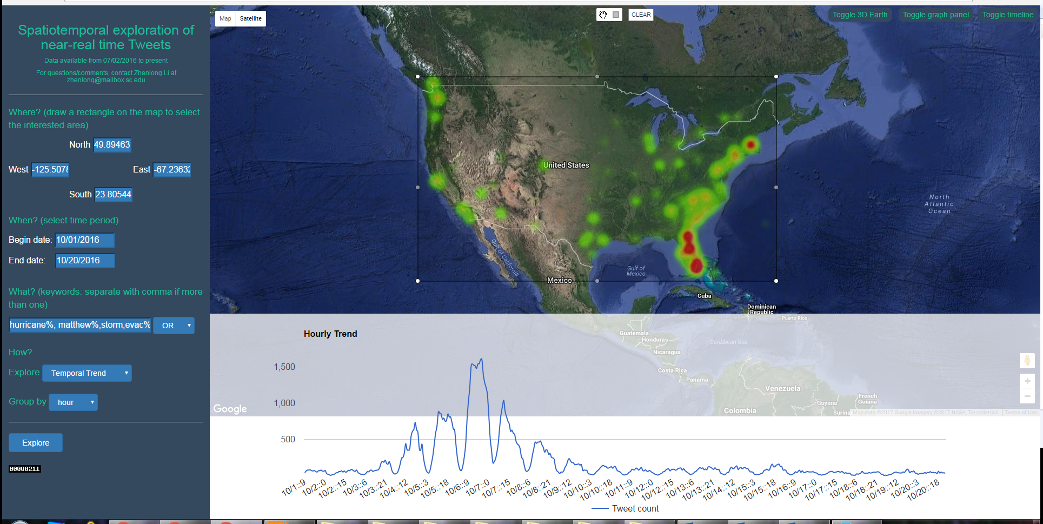
The information explosion (Big Data Era)
In Twitter, people post 500 million tweets per day and around 5% can be directly geocoded.
Spatial and temporal distribution of Hurricane Matthew related tweets

Slide 6
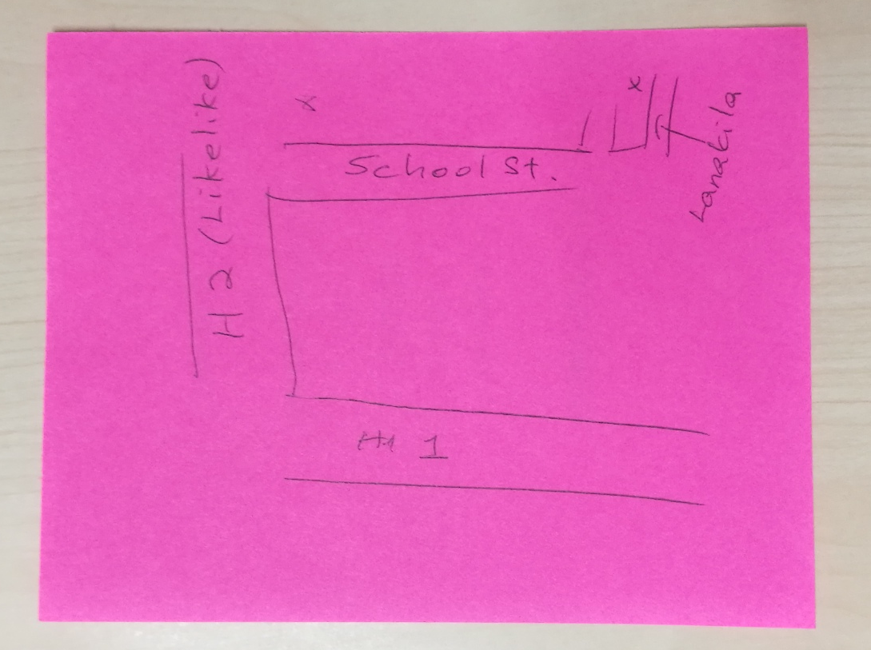
The capacity of our brain

Slide 7
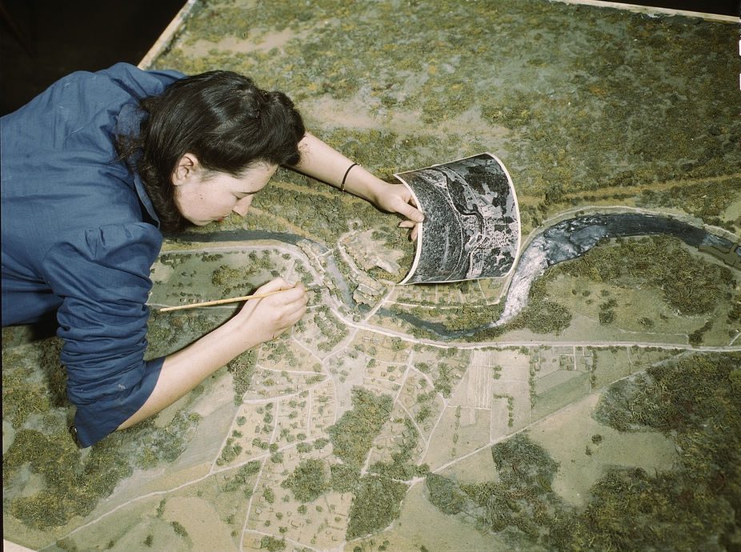

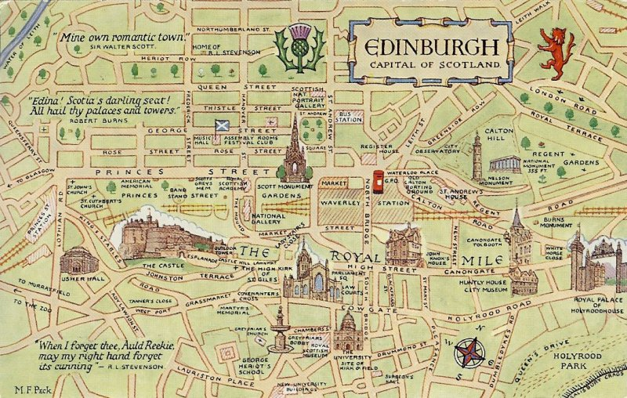
Traditional models of the Earth

Slide 8
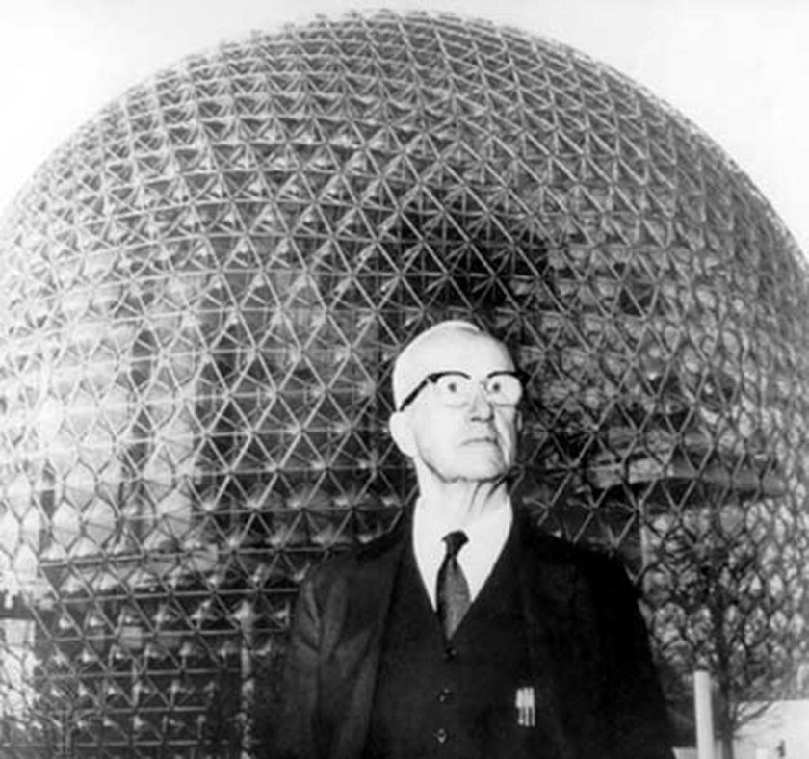
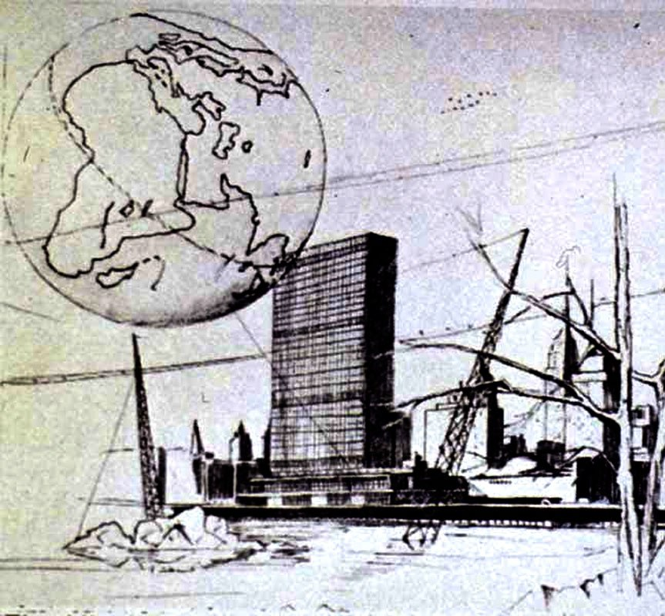
Buckminster’s Geoscope
“… a large two-hundred-foot diameter (or more) lightweight geodesic sphere hung hoveringly at one hundred feet above mid-campus by approximately invisible cables from three remote masts. This giant sphere is a miniature earth. Its entire exterior and interior surfaces will be covered with closely-packed electric bulbs, each with variable intensity controls. The lighting of the bulbs is scanningly controlled through an electric computer." — R. Buckminster Fuller, 1962

Slide 9
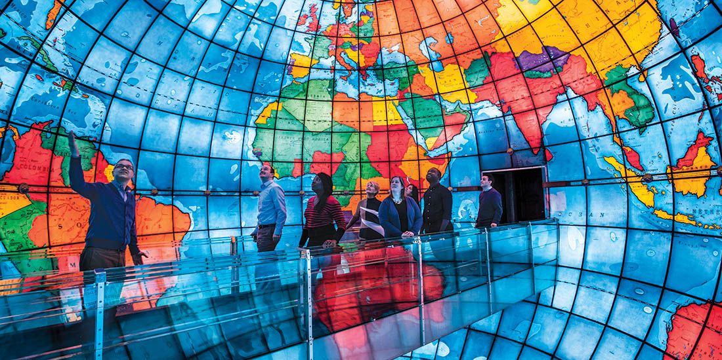
Mapparium: a inside view of the world
A three-story-tall globe made of stained glass that is viewed from a 30-foot-long (9.1 m) bridge through its interior.
Shows the political world in 1935 with orchestration of words, music, and LED lights

Slide 10
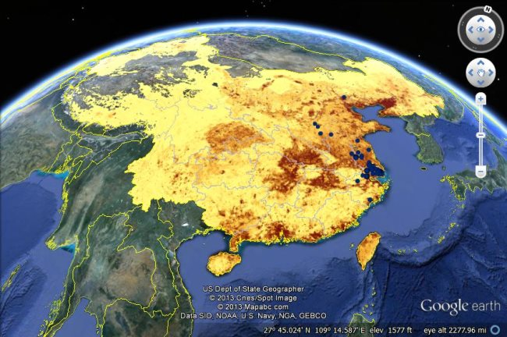
Google Earth

Slide 11
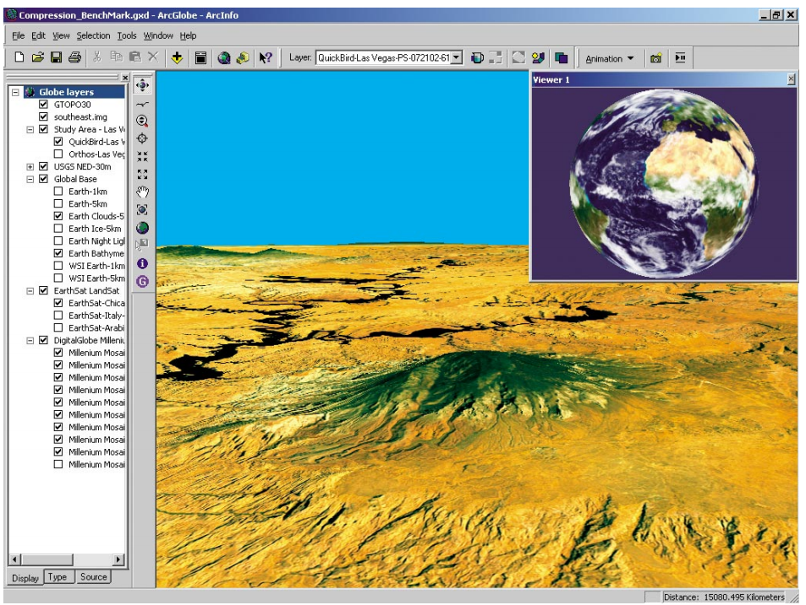
ArcGlobe (ESRI)

Slide 12
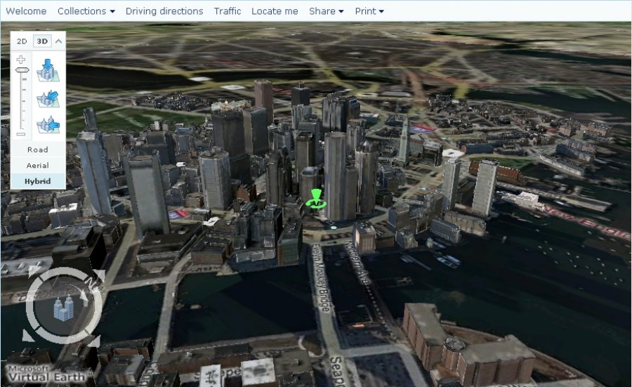
Virtual Earth (Microsoft)

Slide 13
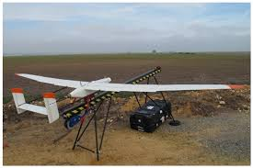
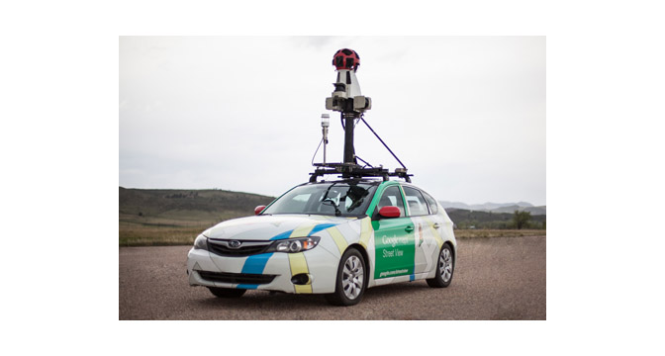
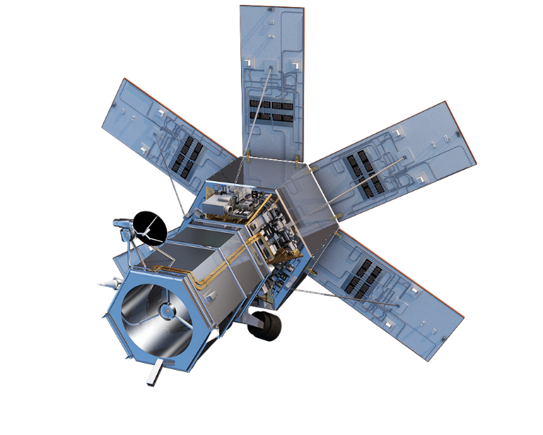
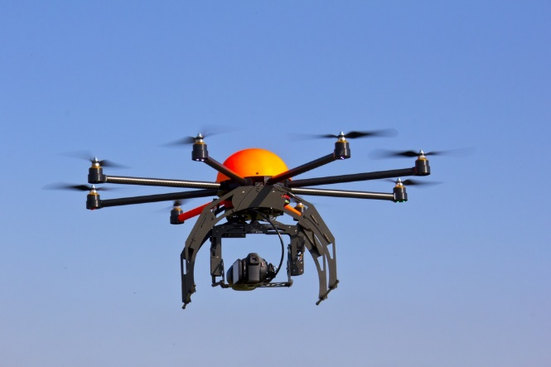
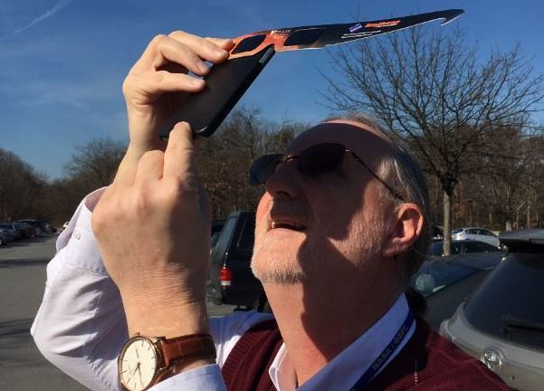
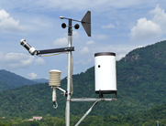
Earth Observation Techniques

Slide 14

Storage of the Big Data

Slide 15

Cyberinfrastructure (distributed computing)

Slide 16
What is Digital Earth
Originated from a speech by Al Gore at Los Angeles on January 31, 1998.
New technologies allow us to capture, store, process and display an unprecedented amount of information about our planet.
Much of this information is "georeferenced" - that is, it will refer to some specific place on the Earth’s surface.
Processing such vast amount of information is beyond the capacity of human brains and other media – it has to be done by computers.

Slide 17
What can the Digital Earth do?
3-D representation of the planet, into which we can embed vast quantities of geo-referenced data
Higher and higher levels of resolution to see continents, then regions, countries, cities, and finally individual houses, trees
Moves backward in time to learn about history, perusing digitized maps overlaid on the surface of the Digital Earth, newsreel footage, oral history, newspapers and other sources.
It is a "collaboratory"-- a laboratory without walls — for research scientists to share, integrate and interoperate their data and models.
Based on the advancement of computer science, earth observation, global positioning system, the internet, and cyberinfrastructure.

Slide 18
This course will include
Common methods to digitalize the Earth – how we code the Earth as mathematical and computer models.
Digital mapping techniques to represent human and environmental interactions on the Earth.
Basic skills of using geographical information systems (GIS) to analyze geospatial data.
Emerging technologies to collect, process, manage and analyze the vast amount of information about the Earth.

Slide 19
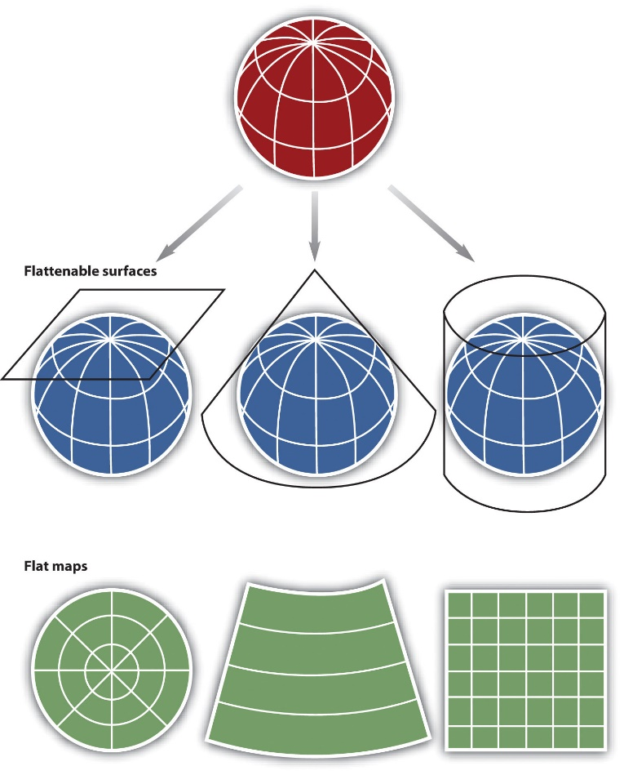
This course will include
Map projections

Slide 20
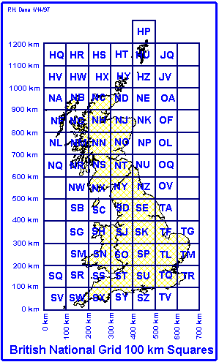
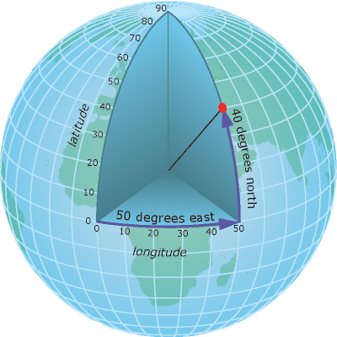
This course will include
Georeferencing and coordinate systems
Geographic coordinate system
National Grid of UK

Slide 21
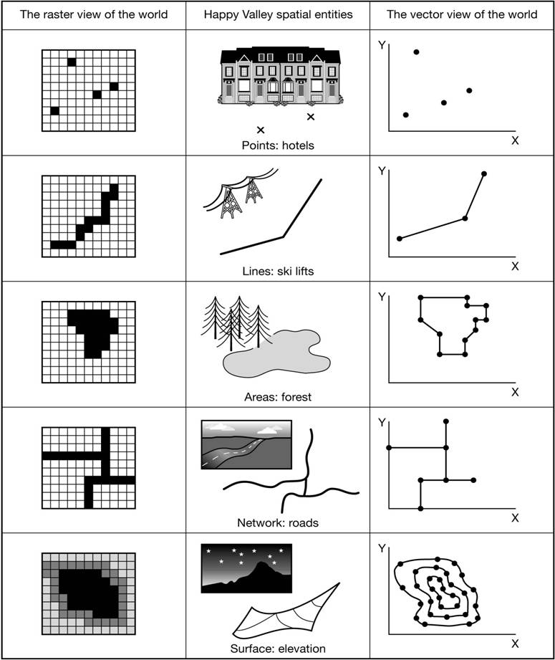
This course will include
The representations of space

Slide 22
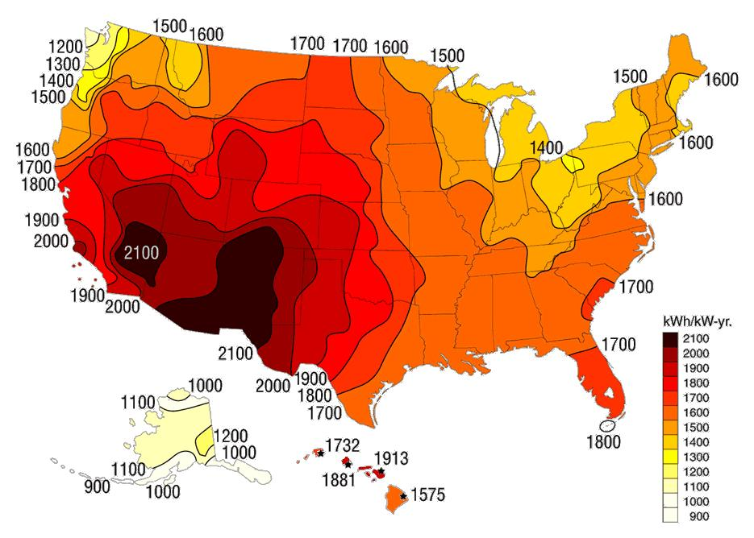
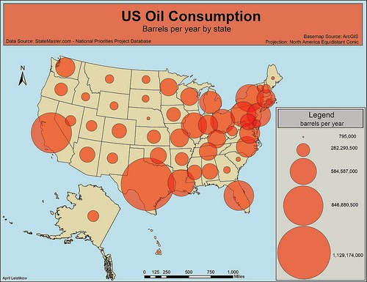
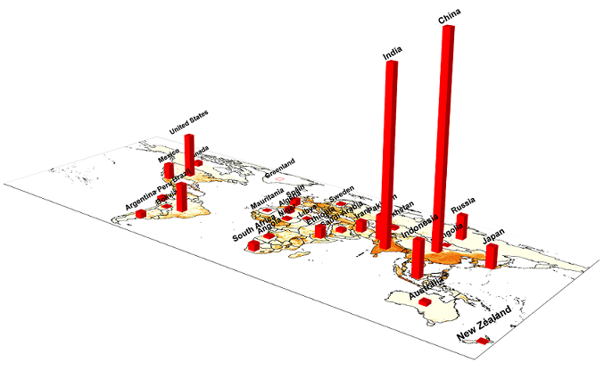
This course will include
Reading and creating mapping

Slide 23
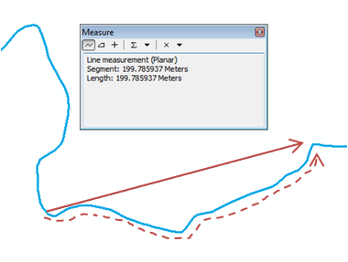
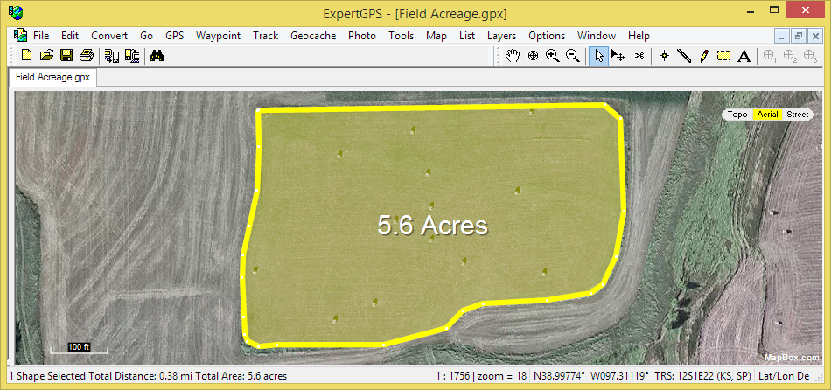
This course will include
Measurement and analysis in map

Slide 24
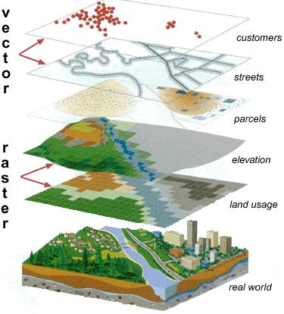
This course will include
Geographic information systems

Slide 25
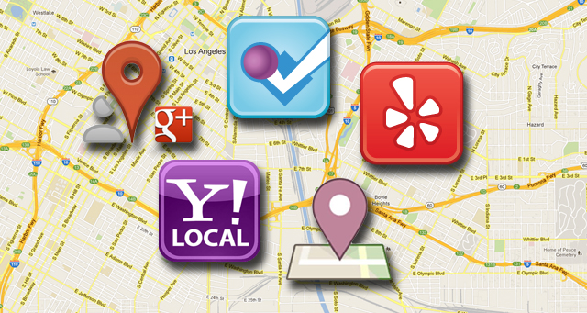
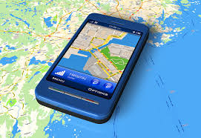
This course will include
Mobile maps and location-based service

Slide 26
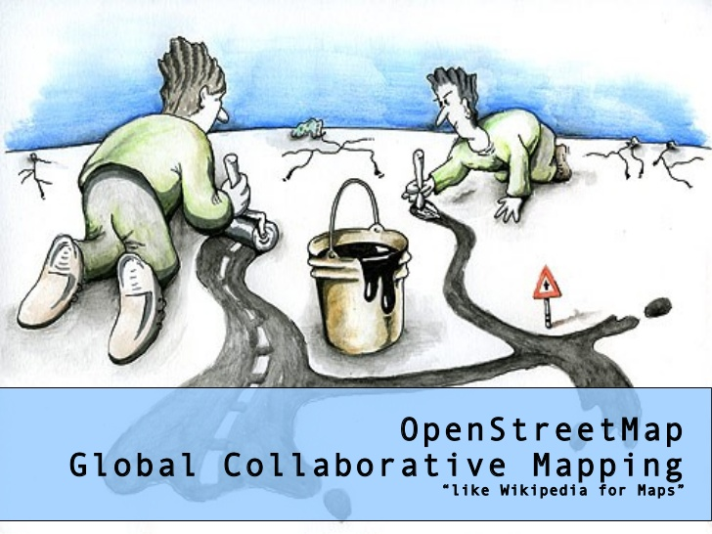
This course will include
Volunteer-GIS or public-participating GIS

Slide 27
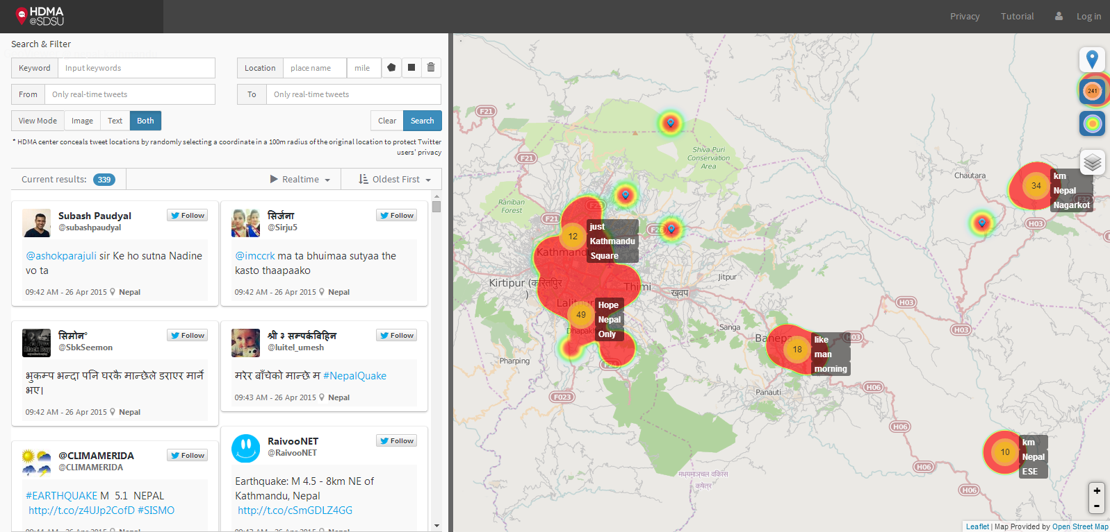
This course will include
Crowdsourced data (e.g. social media data)

Slide 28
Approaches to Lectures & Labs
An overview of geospatial technologies and trending development
Combination of theories, applications and case studies
Including both lectures and lab exercises
Home assignments will be given weekly
After-class readings will be recommended
Evaluation will be based on home assignments, mid-term and final exams.

Slide 29
Course rules
Do
Ask anytime when you have questions (raise your hands)
Comments and open discussion is encouraged (raise your hands)
Ask me questions after class (email or office hour)
Submit your home assignments on time
Do not
Be late (>15min late deemed as absence)
Talking out of the topic
Use cell phone in class (mute your phone)
Other disruptive behavior

Slide 30
Evaluation
12 lab exercises/home assignments (60%)
Mid-term (10%)
Final (20%)
Participation (10%)

Slide 31
Social sensing in Twitter
Using Twitter to Track Eclipse Visitors to the Midlands

